Slide 1
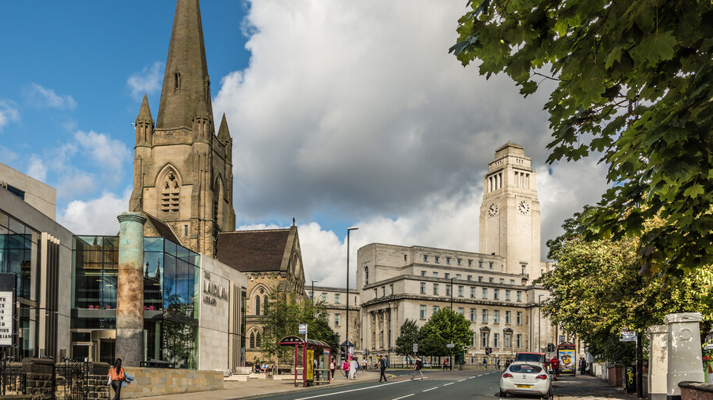
How the
University works
The following slides have been created to support the induction of new staff, they include diagrams and descriptions to help colleagues gain an understanding of how the University works, particularly for those new to the University or Higher Education.

Slide 2
Visual overview of how the University works
Council
(governing body, membership)
approves
approves
responsible to
University Executive
(membership)
This diagram provides a visual overview of how the University works.
It shows how groups within the institution work to deliver university activity.
It is described on the next slide in more detail.
Use the links to click to further information.
Links marked with * are only available through remote desktop or on campus.
implements
proposes & implements
advises
advises
Senate (academic governance)
consulted on
advises
approves programmes of study through delegated authority and committee cycle
Faculties & corporate services
determines policy
deliver
approves research grant applications through Faculty Research Office
Strategy
University activity
Including student education, and research and innovation
budget
for
student fee and research grant income
Resource Allocation [Model] (RAM)
Integrated Planning Exercise (IPE)*
aligns
aligns

Slide 3
Description of how the University works
The Council
The Council is the University’s governing body.
It approves the university strategy and the Resource Allocation Model (or RAM).
The Council also appoints the Vice-Chancellor.
The University Executive
The University Executive consists of the Vice-Chancellor, Deputy Vice-Chancellors, Executive Deans, the Secretary, Chief Financial Officer and Chief Operating Officer.
It proposes and implements university strategy, implements the Resource Allocation Model and is responsible to the Council.
The Senate
The Senate is responsible for academic governance.
It advises the University Executive on a number of matters, including the strategy.
The Senate also advises The Council.
The Senate is responsible for determining policy on academic matters and approving programmes of study (degree courses) through delegated authority to its boards and the committee cycle. Research grant applications are approved through Faculty Research and Innovation Offices. Familiaries yourself with these approval processes to help you align your work with their deadlines and other requirements.
The Senate is also consulted on resource allocation.

Slide 4
Description of how the University works (continued)
The University Strategy
The university strategy describes the overall approach that is taken for providing student education, doing research and innovation, international activity and digital transformation.
The University receives income for providing student education in the form of fees and for doing research and innovation in the form of grants.
Resource Allocation Model (RAM) and Integrated Planning Exercise (or IPE)
The implementation of the Resource Allocation Model distributes income as budget to the seven faculties and the corporate services that deliver University activity, including student education, research and innovation.
The annual Integrated Planning Exercise (or IPE) aligns the Resource Allocation Model with the university strategy.
To give a sense of where financial responsibilities sit:
Transactions of more than three million pounds need approval by Council,.
Transactions between three million and one million pounds need the approval of the University Executive as a group.
Transactions of less than one million pounds can be approved by individual members of the University Executive.
More detail can be found on the Secretariat website in the University’s charter and the Scheme of Delegation (PDF).

Slide 5
High-level organisational chart
Chancellor Ambassadorial and ceremonial role
Council (Governing Body) Chaired by Pro Chancellor
This diagram provides an overview of academic management role.
It outlines which roles are in the University executive, who reports to them and whom they report to.
It is described on the next slide in more detail.
The links in the diagram allow you to find out who current role holders are and more about their responsibilities.
Pri
Vice-Chancellor and President (VC)
University Executive
Principal DeputyVice-Chancellor and Provost (PDVC)
Deputy Vice-Chancellor – Student Education (DVC SE)
Deputy Vice-Chancellor – Research and Innovation (DVC R&I)
University Secretary
Chief Financial Officer (CFO)
Chief Operating Officer (COO)
Executive Deans (one for each Faculty)
Pro Vice-Chancellor (PVC): Digital Transformation
Pro Vice-Chancellor: Business Engagement and Enterprise
Deans
Deans
Deans including Dean of the Doctoral College
Pro Dean International
Pro Dean Student Education
Pro Dean Research and Innovation
Director of the Faculty Graduate School
Heads of School and equivalents
Directors of… (Student Education etc)

Slide 6
High-level organisational chart description
The Chancellor is an ambassador for the university and has ceremonial duties. The Chancellor is not involved with the running of the university.
The Pro Chancellor chairs the Council, the governing body of the university to which the Vice-Chancellor reports.
The Vice-Chancellor and President leads the University Executive which includes the Principal Deputy Vice-Chancellor and Provost, Deputy Vice-Chancellor for Student Education, Deputy Vice-Chancellor for Research and Innovation, the Secretary, Chief Financial Officer (CFO), and Chief Operating Officer.
The Principal Deputy Vice-Chancellor serves as a ‘standing deputy’ for the Vice-Chancellor; provides oversight and coordination of the University’s academic strategy and its planning and delivery; and leads on the University’s international strategy. The Executive Deans report to the Principal Deputy Vice-Chancellor.
Each Executive Dean is supported by a Pro Dean International, a Pro Dean for Student Education, a Pro Dean for Research and Innovation, a Director of the Faculty Graduate School and has responsible to them a Head of School, or equivalent, for each organisational unit in the faculty. These are mostly schools but also include institutes and divisions. The Executive Dean, Pro Deans, Director of the Graduate School and Heads of School form the Faculty Executive.

Slide 7
High-level organisational chart description (continued)
There is a Pro Vice-Chancellor (PVC): Digital Transformation who reports to the Deputy Vice-Chancellor.
There is a Pro Vice-Chancellor: Business Engagement and Enterprise who reports to the Deputy Vice-Chancellor – Research and Innovation.
Each Head of School or equivalent is supported by a Director of Student Education, a Director of Research and Innovation and a Director of Postgraduate Research Studies. These roles make up the School Executive.
As well as the reporting line described and shown in the diagram the Directors of Student Education also report to the Pro Dean for Student Education in their faculty and the Pro Deans for Student Education report to the Deputy Vice-Chancellor for Student Education. A similar pattern exists for international matters, Research and Innovation, and Postgraduate Research Studies. In the case of the Directors of Postgraduate Studies they also report to the Director of their faculty graduate School who in turn report to the Dean of the Doctoral College.
Deans are appointed to support members of the executive with particular aspects of their role. The example shown in the diagram is the Dean of the Doctoral College who leads on the Postgraduate Research agenda on behalf of the Deputy Vice-Chancellor for Research and Innovation.

Slide 8
Diagram of University Executive responsibilities for central services
This diagram shows which services each of the University Executive is responsible for.
It is described on the next slide.
The links in the diagram allow you to find out about the services.
Deputy Vice-Chancellor (DVC)
Deputy Vice-Chancellor – Student Education (DVC SE)
Deputy Vice-Chancellor – Research and Innovation (DVC R&I)
University Secretary
Chief Financial Officer (CFO)
Chief Operating Officer (COO)
Strategy and Planning
Library
Lifelong Learning Centre
Research and Innovation Service
Nexus
Risk
Secretariat
Wellbeing, Safety and Health
Communications
Finance
Procurement
Marketing
International
Admissions
Educational Engagement
Marketing
International Pathways Centre
People and Culture
Organisational Development and Professional Learning
Equality and Inclusion
Human Resources
Student Education Service
Student Opportunity
Student Operations
Facilities
Estates
Residences
Sustainability
Commercial Services
IT
Advancement
Deputy COO
Digital Education Service
Transformation Office

Slide 9
Description of University Executive responsibilities for central services
The Deputy Vice-Chancellor is responsible for Strategy and Planning.
The Deputy Vice-Chancellor – Student Education is responsible for the Library and the Lifelong Learning Centre.
The Deputy Vice-Chancellor – Research and Innovation is responsible for the Research and Innovation Service and Nexus.
The Secretary is responsible for Risk, the Secretariat, Wellbeing, Safety and Health, and Communications.
The Chief Financial Officer is responsible for Finance, and Procurement.
The Chief Operating Officer is responsible for
Marketing - includes International, Admissions, Educational Engagement, Marketing, International Pathways Centre;
People and Culture - includes Organisational Development and Professional Learning, Equality and Inclusion, and Human Resources;
Student Education Service - includes Student Opportunity, and Student Operations;
Facilities - includes Estates, Residences, Sustainability, and Commercial Services;
IT
Advancement.
The Deputy Chief Operating Officer, reports to the Chief Operating Officer, and is responsible for the Digital Education Service, and Transformation Office.

